Slide 1


Computational Intelligence (TC2027)

Slide 2

Unit 3 – Cryptography Technology (I)
Cryptography Foundations
Symmetric Encryption
Message Authentication and Hash Function

Slide 3
Cryptography Foundations

Slide 4

What is Cryptography?
Cryptography is the practice and study of hiding information.
It is the Art or Science of converting a plain intelligible data into an unintelligible data and again retransforming that message into its original form.

Slide 5
Purpose of Cryptography
Authentication: The process of proving one's identity. (The primary forms of host-to-host authentication on the Internet today are name-based or address-based, both of which are notoriously weak.)
Privacy/confidentiality: Ensuring that no one can read the message except the intended receiver.
Integrity: Assuring the receiver that the received message has not been altered in any way from the original.
Non-repudiation: A mechanism to prove that the sender really sent this message.

Slide 6
Symmetric Encryption

Slide 7
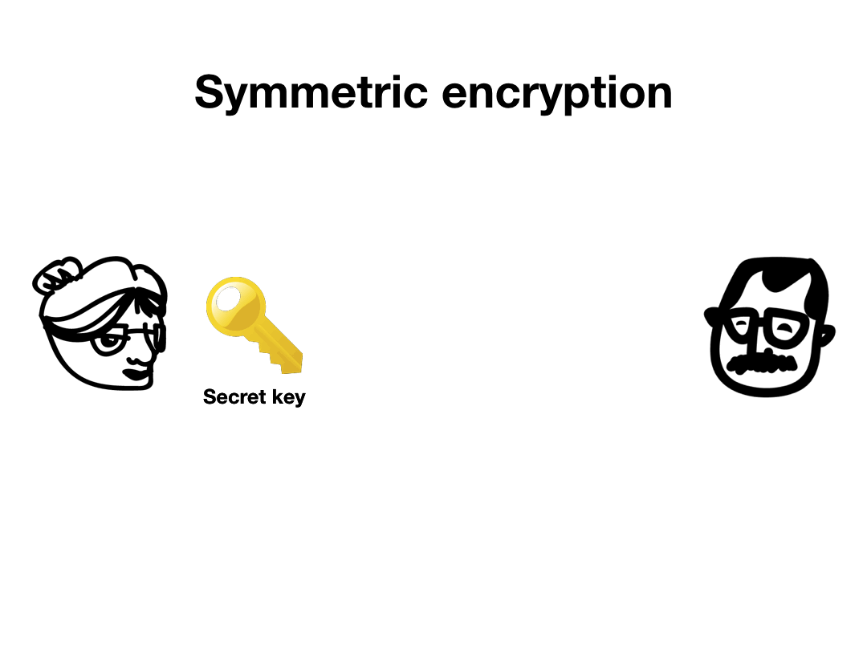
Symmetric Encryption
Symmetric encryption refers to encryption methods in which both the sender and receiver share the same key (or, less commonly, in which their keys are different, but related in an easily computable way).

Slide 8
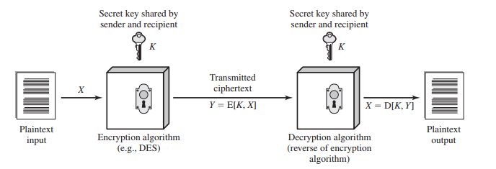
Symmetric Encryption Components
Plaintext: This is the original message or data that is fed into the algorithm as input.
Encryption algorithm: The encryption algorithm performs various substitutions and transformations on the plaintext.
Secret key: The secret key is also input to the encryption algorithm. The exact substitutions and transformations performed by the algorithm depend on the key.
Ciphertext: This is the scrambled message produced as output. It depends on the plaintext and the secret key. For a given message, two different keys will produce two different ciphertexts.
Decryption algorithm: This is essentially the encryption algorithm run in reverse. It takes the ciphertext and the secret key and produces the original plaintext.

Slide 9

How to break a Symmetric Cryptography?
Crypto-analysis: Cryptanalytic attacks rely on the nature of the algorithm plus perhaps some knowledge of the general characteristics of the plaintext or even some sample plaintext-ciphertext pairs. This type of attack exploits the characteristics of the algorithm to attempt to deduce a specific plaintext or to deduce the key being used.
Brute-force attack: is to try every possible key on a piece of ciphertext until an intelligible translation into plaintext is obtained.

Slide 10

Brute-Force Attack – Broking Caesar's Cypher

Slide 11
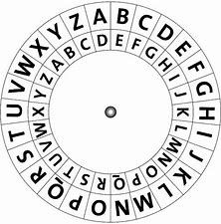
Caesar's Cypher
The Caesar cipher is named after the legendary Roman emperor Julius Caesar, who used it to protect his military communications.
It is a simple substitution cipher, where each letter corresponds to another letter a certain number of positions forward or backward in the alphabet.
For example, a shift right of 5 would encode the word Caesar as “hfjxfw”.
Due to this simplicity, the Caesar cipher offers little security against those with even a passing knowledge of cryptography.
Remember: in ancient Rome, most people were illiterate or semi-literate!

Slide 12
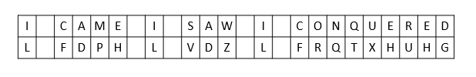
Caesar's Cypher
The easiest way to understand the Caesar cipher is to think of cycling the position of the letters.
In a Caesar cipher with a shift of 3, A becomes D, B becomes E, C becomes F, etc. When reaching the end of the alphabet it cycles around, so X becomes A, Y becomes B and Z becomes C.
Ex.: In this example the phrase “I came, I saw, I conquered” becomes “L FDPH, L VDZ, L FRQTXHUHG” once encoded with a shift of 3.

Slide 13
Breaking the Caesar's Cypher
Breaking a Caesar cipher usually follows one of three scenarios depending on the amount of knowledge the attacking cryptanalyst has:
The cryptanalyst knows that the cipher is a Caesar cipher.
The cryptanalyst knows that the cipher is substitution cipher, but not a Caesar cipher.
The cryptanalyst is totally unaware of the kind of cipher they are faced with.

Slide 14
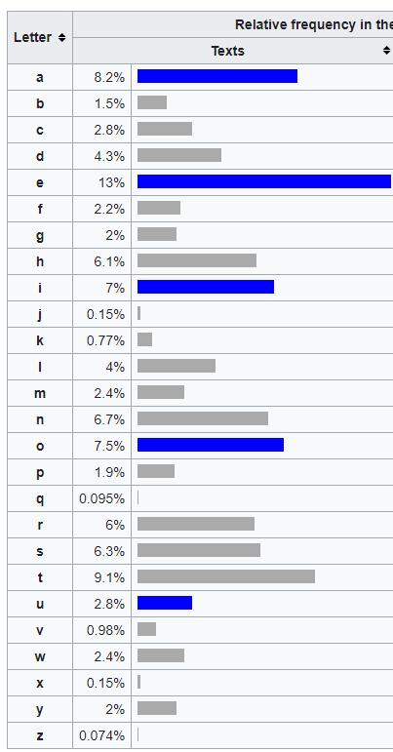
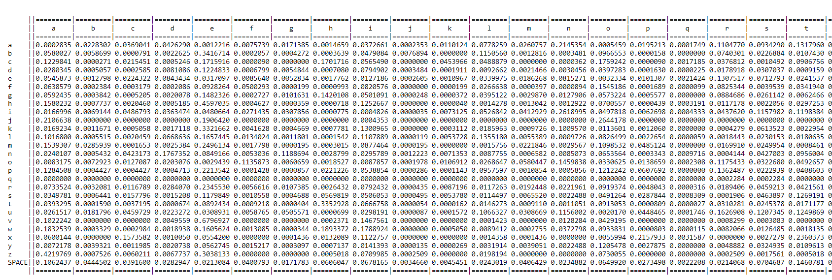
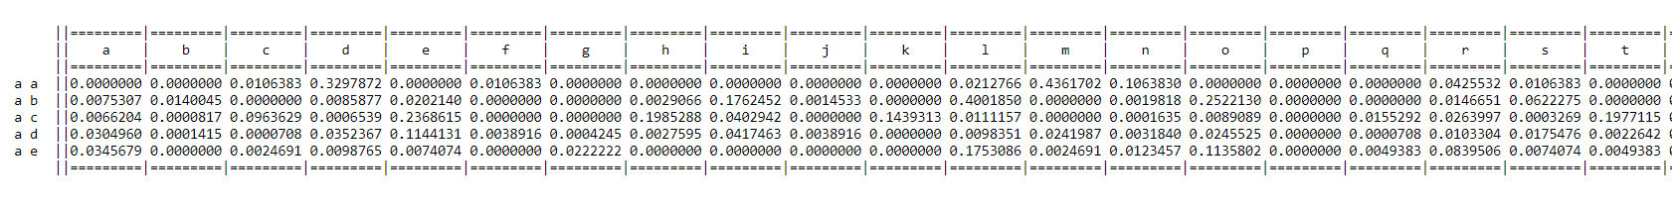
Breaking the Caesar's Cypher
One method is to create a list of words that could be the possible key phrase and attempt a brute force attack.
Another method is to employ frequency analysis.

Slide 15
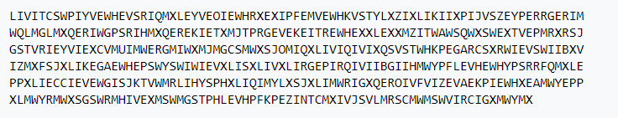
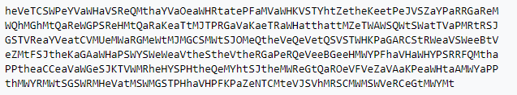
Breaking the Caesar's Cypher
Eve could use frequency analysis to help solve the message along the following lines:
counts of the letters in the cryptogram show that I is the most common single letter, XL most common bigram, and XLI is the most common trigram. e is the most common letter in the English language, th is the most common bigram, and the is the most common trigram.
This strongly suggests that X~t, L~h and I~e. The second most common letter in the cryptogram is E; since the first and second most frequent letters in the English language, e and t are accounted for, Eve guesses that E~a, the third most frequent letter.
Tentatively making these assumptions, the following partial decrypted message is obtained.

Slide 16
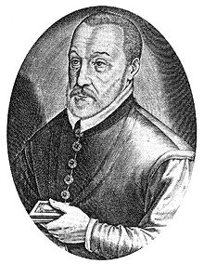
Crypto-analysis Attack – Broking Vigenère Cypher

Slide 17
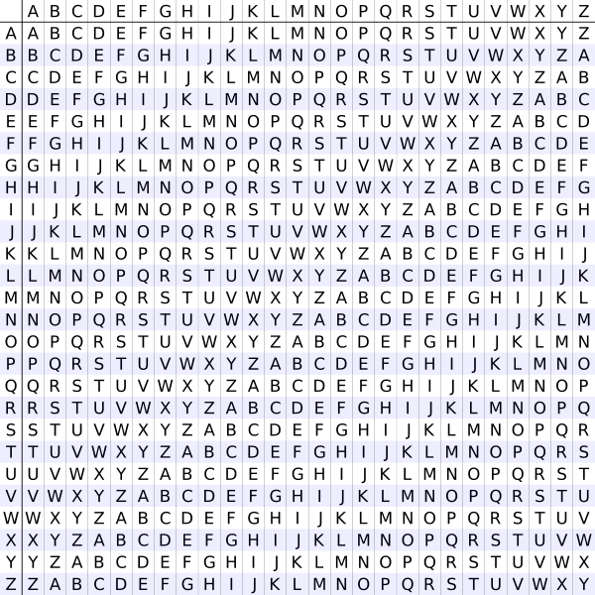
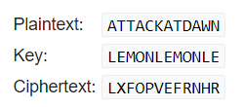
Vigenère Cypher
The Vigenère cipher is a method of encrypting alphabetic text by using a series of interwoven Caesar ciphers, based on the letters of a keyword.
It employs a form of polyalphabetic substitution.

Slide 18
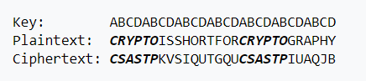
Breaking the Vigenère Cypher - Kasiski examination
The Kasiski examination, also called the Kasiski test, takes advantage of the fact that repeated words are, by chance, sometimes encrypted using the same key letters, leading to repeated groups in the ciphertext.
For example, consider the following encryption using the keyword ABCD:

Slide 19
Breaking the Vigenère Cypher - Kasiski examination
The distance between the repetitions of CSASTP is 16.
If it is assumed that the repeated segments represent the same plaintext segments, that implies that the key is 16, 8, 4, 2, or 1 characters long.
Since key lengths 2 and 1 are unrealistically short, one needs to try only lengths 16, 8 or 4.
Longer messages make the test more accurate because they usually contain more repeated ciphertext segments.

Slide 20
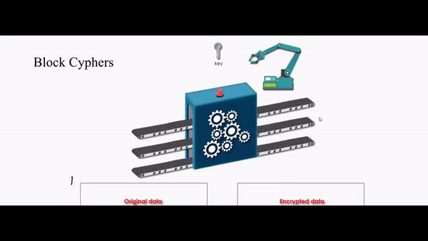
Symmetric Block Encryption Algorithms
The most used symmetric encryption algorithms are block ciphers.
A block cipher processes the plaintext input in fixed-size blocks and produces a block of ciphertext of equal size for each plaintext block.
The algorithm processes longer plaintext amounts as a series of fixed-size blocks.

Slide 21
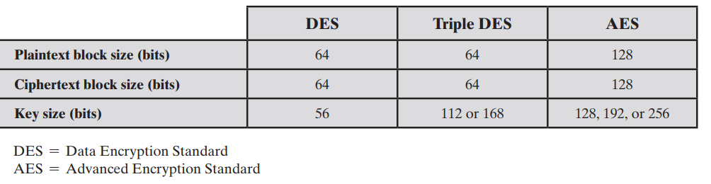
Symmetric Block Encryption Algorithms

Slide 22
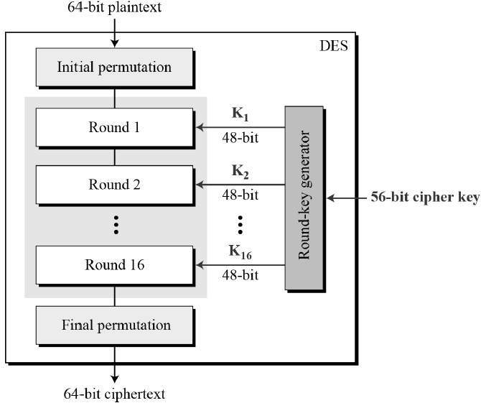
Data Encryption Standard (DES)
Data Encryption Standard (DES) adopted in 1977 by the National Bureau of Standards, now (NIST), as Federal Information Processing Standard 46 (FIPS PUB 46).
The algorithm itself is referred to as the Data Encryption Algorithm (DEA).
DES takes a plaintext block of 64 bits and a key of 56 bits, to produce a ciphertext block of 64 bits.

Slide 23
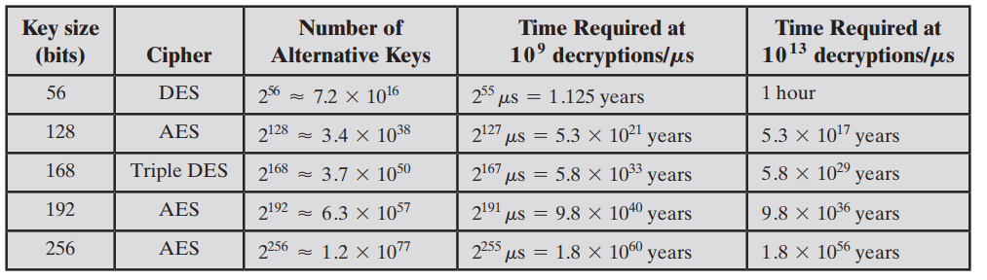
Concerns about the strength of DES:
algorithm: refers to the possibility that cryptanalysis is possible by exploiting the characteristics of the DES algorithm. Despite numerous approaches, no one has so far reported a fatal weakness in DES.
Key size (56 bits): it is the problem!

Slide 24
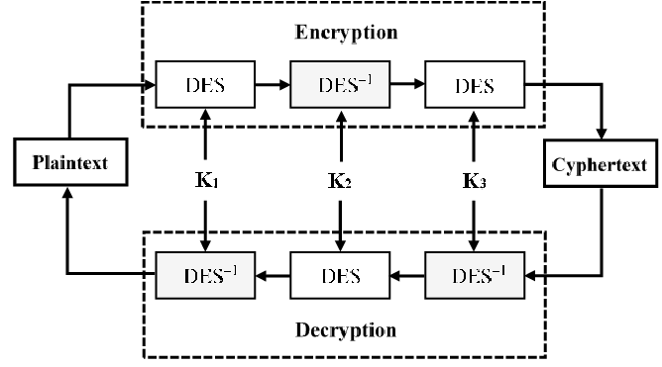
3DES
The life of DES was extended by the use of triple DES (3DES), which involves repeating the basic DES algorithm three times, using either two or three unique keys, for a key size of 112 or 168 bits.

Slide 25
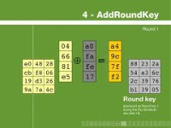
Advanced Encryption Standard (AES)

Slide 26
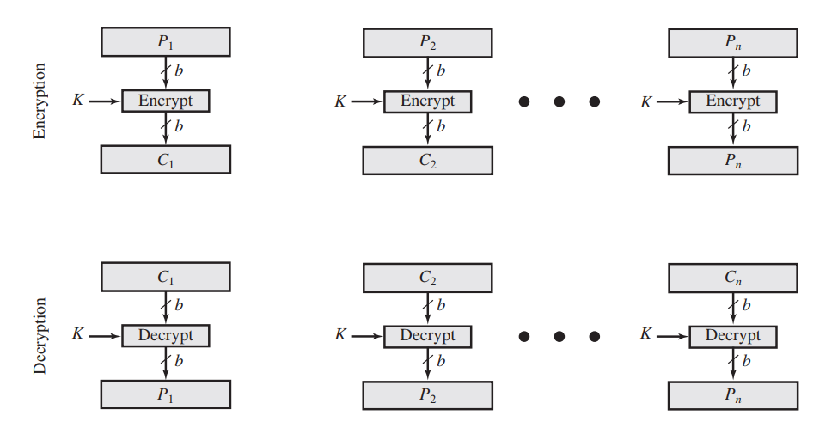
Electronic CodeBook (ECB)
It is an approach to multiple-block encryption, which plaintext is handled b bits at a time and each block of plaintext is encrypted using the same key.

Slide 27
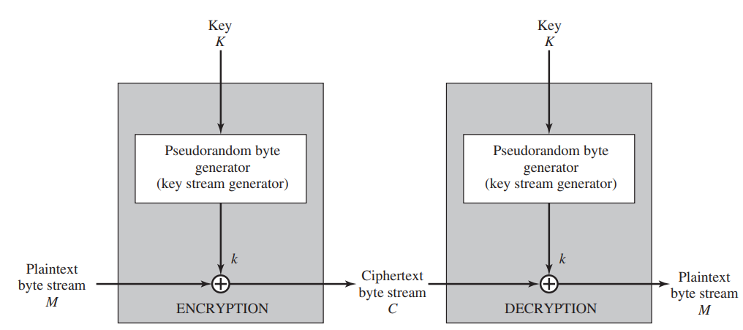
Stream Ciphers
A block cipher processes the input one block of elements at a time, producing an output block for each input block.
A stream cipher processes the input elements continuously, producing output one element at a time, as it goes along.
The output of the generator, called a keystream, is combined one byte at a time with the plaintext stream using the bitwise exclusive-OR (XOR) operation.

Slide 28
Message Authentication and Hash Function

Slide 29

Basic Considerations
Encryption protects against passive attack (eavesdropping).
A different requirement is to protect against active attack (falsification of data and transactions).

Slide 30
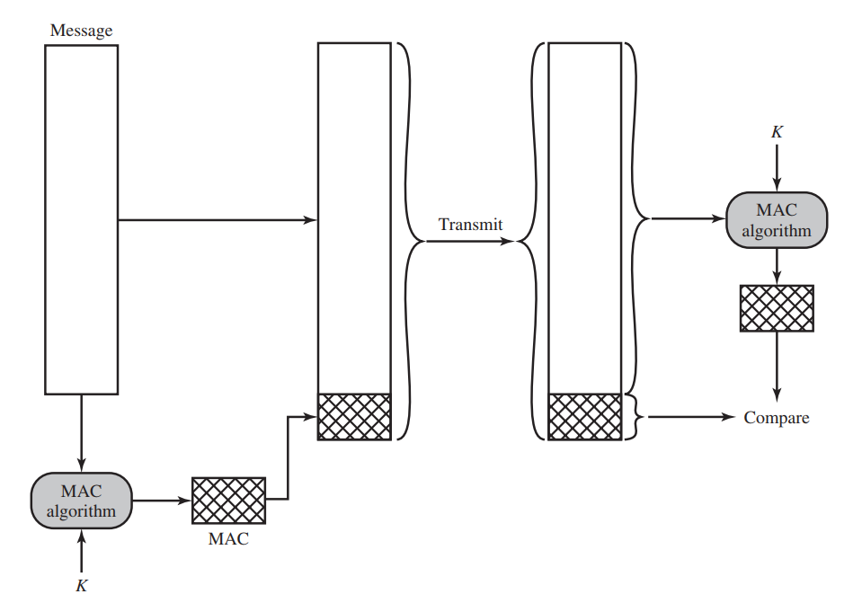
Message Authentication Code
One authentication technique involves the use of a secret key to generate a small block of data, known as a message authentication code, that is appended to the message.
This technique assumes that two communicating parties, say A and B, share a common secret key K_{AB}.
Message authentication code as a complex function of the message and the key: MACM = F(KAB, M).

Slide 31
One-Way Hash Function
An alternative to the message authentication code is the one-way hash function.
As with the message authentication code, a hash function accepts a variable-size message M as input and produces a fixed-size message digest H(M) as output.
Typically, the message is padded out to an integer multiple of some fixed length (e.g., 1024 bits) and the padding includes the value of the length of the original message in bits.
Unlike the MAC, a hash function does not take a secret key as input.

Slide 32
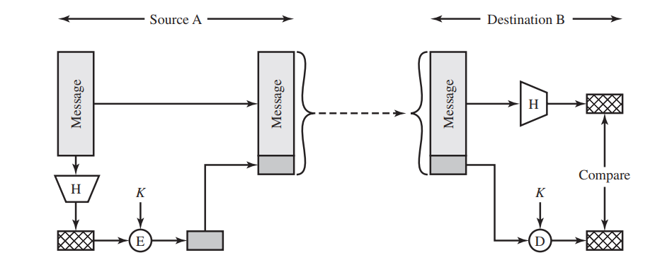
One-Way Hash Function

Slide 33
Hash Function Requirements
H can be applied to a block of data of any size.
H produces a fixed-length output.
H(x) is relatively easy to compute for any given x, making both hardware and software implementations practical.
For any given code h, it is computationally infeasible to find x such that H(x) = h. A hash function with this property is referred to as one-way or preimage resistant.
For any given block x, it is computationally infeasible to find y ≠ x with H(y) = H(x). A hash function with this property is referred to as second preimage resistant. This is sometimes referred to as weak collision resistant.
It is computationally infeasible to find any pair (x, y) such that H(x) = H(y). A hash function with this property is referred to as collision resistant. This is sometimes referred to as strong collision resistant.

Slide 34
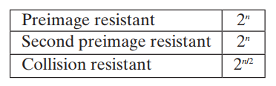
Security Hash Functions
The strength of a hash function against brute-force attacks depends solely on the length of the hash code produced by the algorithm. For a hash code of length n, the level of effort required is proportional to the following:

Slide 35
Other Applications of Hash Functions
Passwords: a hash of a password is stored by an operating system rather than the password itself.
In Linux Passwords are not stored by encrypting with some secret key rather hash of the password is stored.
$ sudo cat /etc/shadow/ techmonger:$6$ABCD1234$JnCx/.NCi4315V0AONxuVpUIRvPivoQjLzY0M28iYkOJU/FwVhXE4Me2f72fldvGEOpnTAB7IuVrsVfwpT/XT/:38478:0:99999:5:::

Slide 36
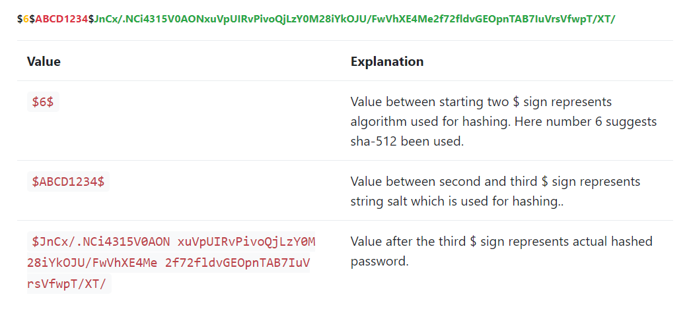
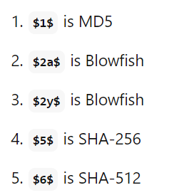
Password

Slide 37
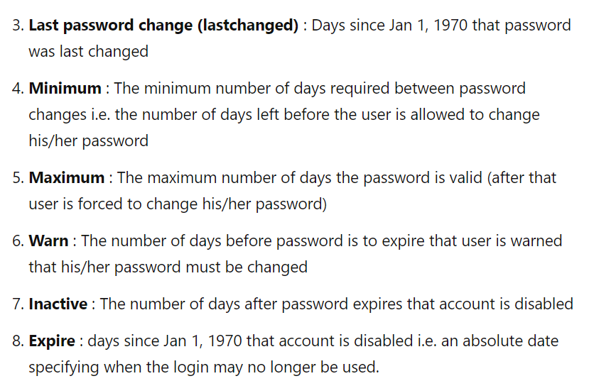
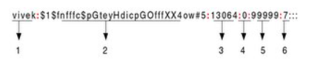
Password

Slide 38
Rainbow Table Attacks
A rainbow table is a database that is used to gain authentication by cracking the password hash.
It is a precomputed dictionary of plaintext passwords and their corresponding hash values that can be used to find out what plaintext password produces a particular hash.
A rainbow table works by doing a cryptanalysis very quickly and effectively. Unlike brute-force attack, which works by calculating the hash function of every string present with them, calculating their hash value and then compare it with the one in the computer, at every step.

Slide 39
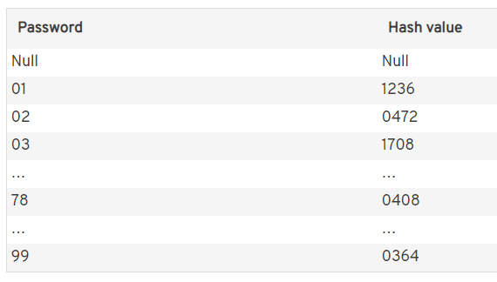
Rainbow Table Attacks
Step 1 - Creating a Table
Here, the hash of a string is taken and then reduced to create a new string, which is reduced again, repeatedly.
Reduction function
(ex.: last two digit)
08

Slide 40
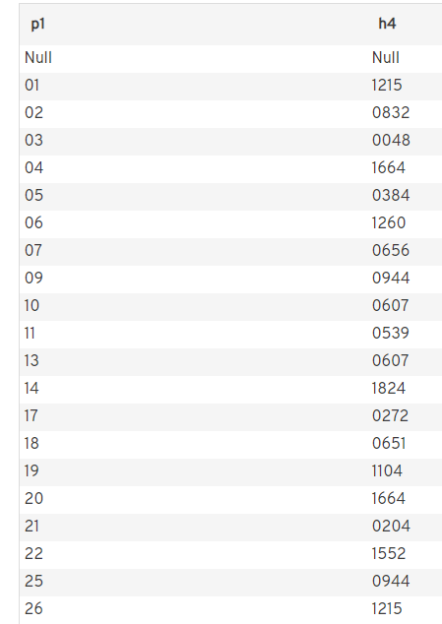
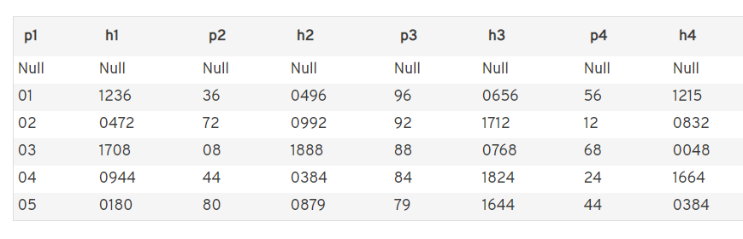
Rainbow Table Attacks
Step 1 - Creating a Table
Repeat the process!!!

Slide 41
Rainbow Table Attacks
Step 2 – Use the Table
You have a hash (1888) and would like to restore the password.
Check in the table created: you see that you do not have any hash with this value.
Do you run the same algorithm with the hash:
1888 -> f(88) = 0768 (no match with table)
0768 -> f(68) = 0488 (is in the third line).
But the password in the same line [h(03) -> 0048] doesn’t belong directly to the hash value, so it’s only the beginning of the chain.
f(03) = 1708
f(08) = 1888 (target hash -> password equals 08!

Slide 42
Avoid Rainbow Table Attacks
To make storage more secure password are hashed with salt.
Salt is just random string which is generated when you create password.
This helps prevent rainbow table attacks.

Slide 43
Other Applications of Hash Functions
Intrusion detection: Store the hash value for a file, H(F), for each file on a system and secure the hash values (e.g., on a CD-R that is kept secure). One can later determine if a file has been modified by recomputing H(F).

Slide 44
Unit 3 – Cryptography Technology (I)
Cryptography Foundations
Symmetric Encryption
Message Authentication and Hash Function

Slide 45
Computational Intelligence (TC2027)

